Slide 1
Paragonimdae
Dr. Alaa Alsandaqchi
Department of Veterinary Parasitology
College of Veterinary Medicine
University of Basrah

Slide 2
Taxonomic Consideration
Kingdom: Animalia
Phylum: Platyhelminthes
Class: Trematoda
Order: Plagiorchiida
Family: Troglotrematidae
Genus: Paragonimus
Species : westermani, kellicotti

Slide 9
Egg
operculum
Operculum = A cap from which worms hatch from the egg. Usually a term specific for Trematodes.

Slide 10
cercariae
metacercariae

Slide 19
(Intermediate 1)
Semisulcospira snail

Slide 20
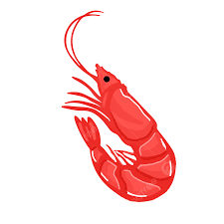
(Intermediate 2)
crustaceans

Slide 25
3. Snail control

Slide 28
Paragonimus westermani
Coffee Bean Shape

